Slide 1


SIMATS ENGINEERING
SAVEETHA INSTITUTE OF MEDICAL AND TECHNICAL SCIENCES
SmartRetail: A Data-Driven Decision Support System for Sustainable Retail Operations
DSA0405 – Fundamentals of Data Science
Guided by:
Dr. Krishnaraj Mony
Associate Professor/CSE
Presented by:
Jeya Harshini R (192424051)
Mythrea shree (192424089)
Selvamagal M(192472013)
Loshane (192424402)

Slide 2


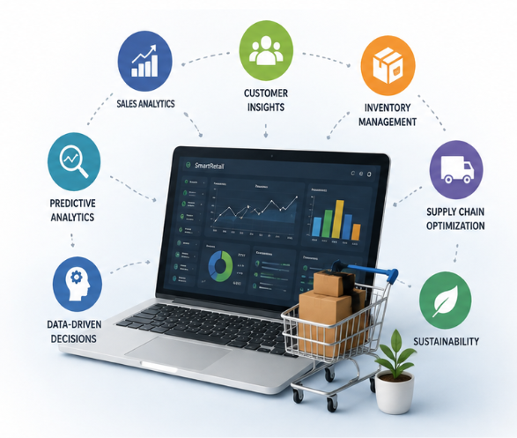
INTRODUCTION
Retail businesses generate large volumes of transactional data through sales, customer purchases, inventory management, and supply chain operations.
Analyzing this data enables organizations to identify business trends, improve operational efficiency, and support informed decision-making.
Retail analytics helps organizations understand customer behavior, optimize inventory levels, improve pricing strategies, and enhance overall business performance.
SmartRetail is proposed as a data-driven decision support system that integrates data preprocessing, business intelligence, predictive analytics, and sustainable recommendations to improve retail operations.

Slide 3
EXISTING SYSTEM
Most retail businesses rely on traditional reporting systems that provide only historical sales data without advanced analytical capabilities.
Retail data is often analyzed manually or using basic spreadsheet tools, making the process time-consuming and prone to human errors.
Existing systems have limited ability to identify hidden patterns, customer behavior, and relationships between sales, profit, and discounts.
Conventional retail management lacks predictive analytics, making it difficult to forecast future sales, demand, and business performance.
Most current solutions do not provide intelligent recommendations for inventory optimization, pricing strategies, or sustainable retail decision-making.

Slide 4
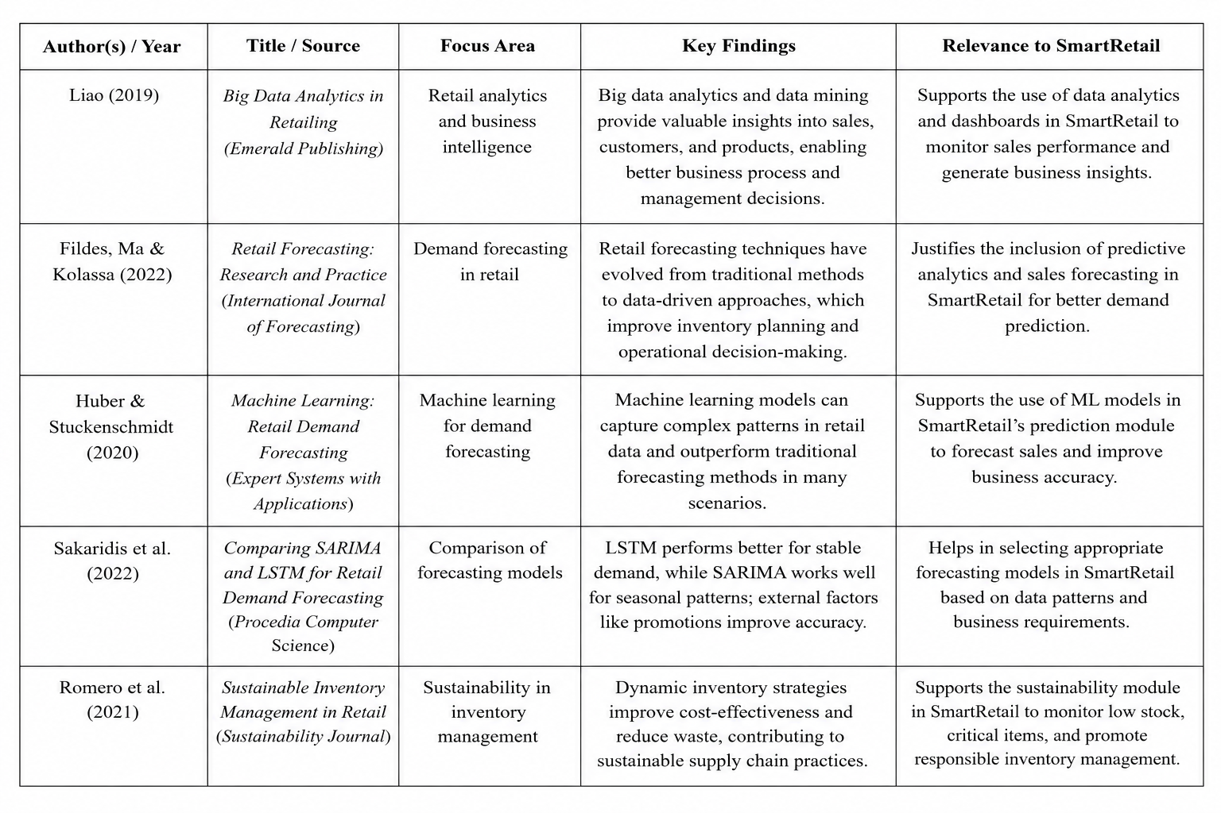
LITERARY REVIEW

Slide 5
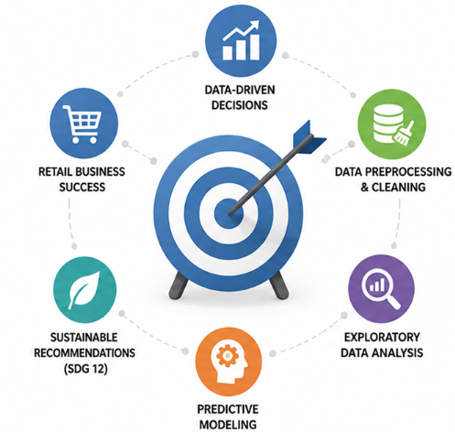
OBJECTIVES
To develop a data-driven decision support system for analyzing retail sales, customer behavior, and business performance.
To preprocess and clean retail transaction data by handling missing values, duplicates, outliers, and data inconsistencies.
To perform exploratory data analysis (EDA) to identify sales trends, customer segments, product performance, and regional insights.
To build predictive models for forecasting retail performance and supporting data-driven business decisions.
To generate sustainable business recommendations for inventory optimization, pricing strategies, and efficient resource utilization in alignment with SDG 12 (Responsible Consumption and Production).

Slide 6
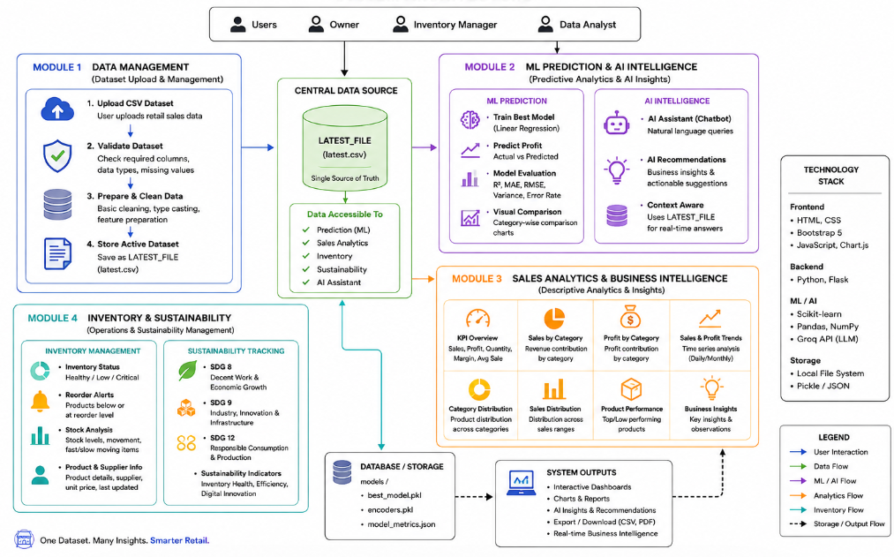
SYSTEM ARCHITECTURE

Slide 7
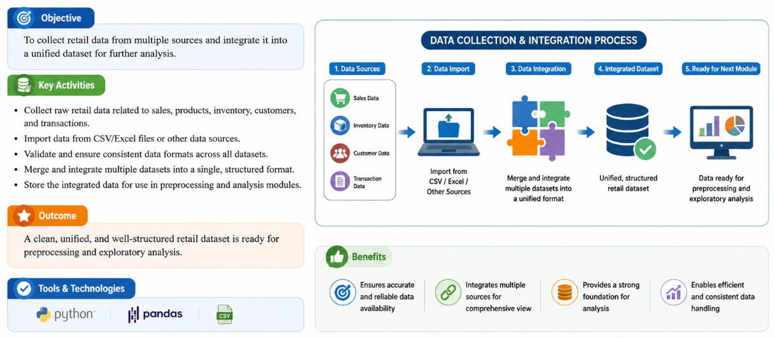
MODULE 1

Slide 8
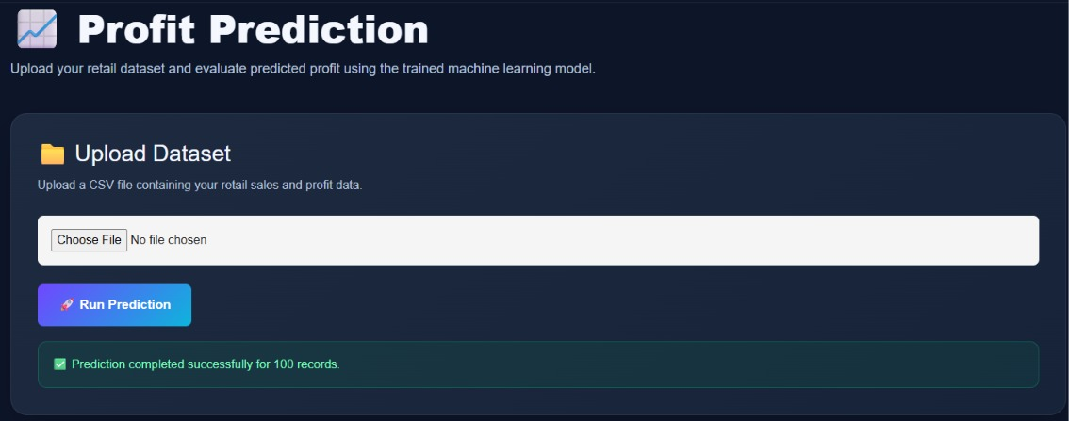
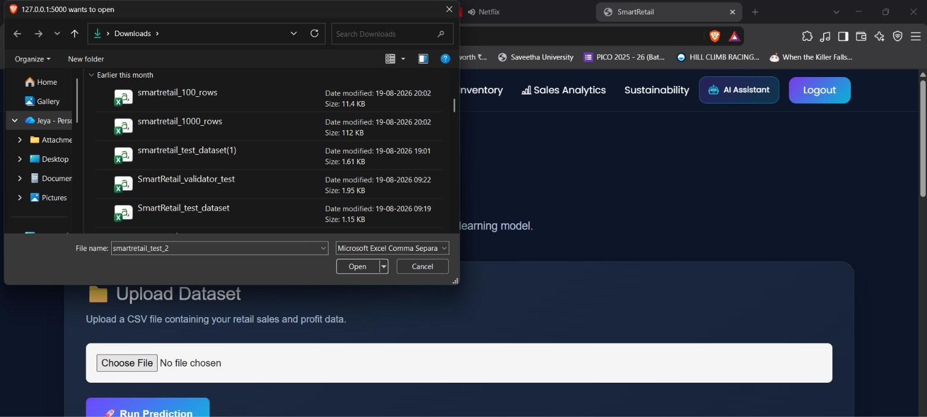
Dataset Upload: Upload the retail sales dataset in CSV format.
Profit Prediction: Run the trained ML model to predict profit accurately.
File Selection: Choose the required retail dataset from your system.
Dataset Upload: Upload the selected CSV file to begin profit prediction.

Slide 9
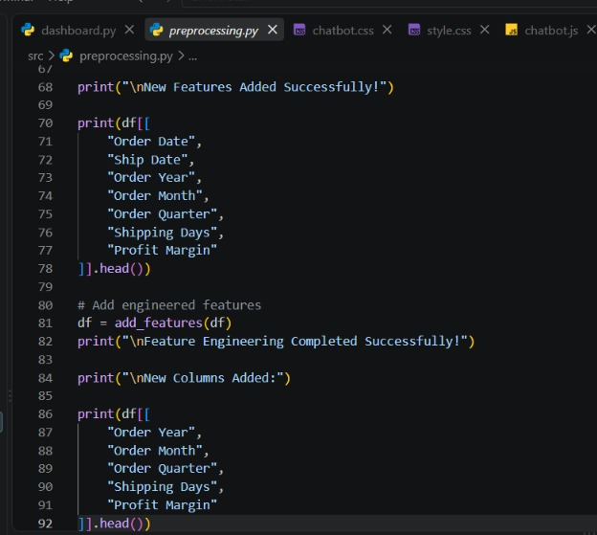
Feature Engineering: Adds new features to improve model performance.
Date Features: Extracts year, month, and quarter from order dates.
Shipping Analysis: Calculates the number of shipping days.
Profit Analysis: Calculates the profit margin for better insights.

Slide 10
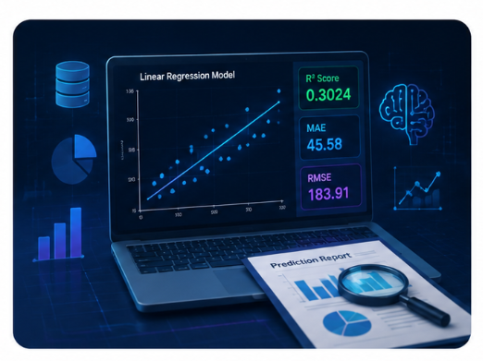
MODULE 2
This module applies machine learning techniques to retail data to uncover patterns, predict outcomes, and support data-driven decisions.
A Linear Regression model is developed to predict financial metrics such as sales and profit using historical data.
Model performance is evaluated using R² Score, Mean Absolute Error (MAE), and Root Mean Square Error (RMSE) to ensure accuracy and reliability.
Actual vs Predicted analysis is performed to measure the error rate and variance, helping to understand model effectiveness.
This module translates analytical insights into predictive intelligence, enabling the system to forecast performance and support strategic planning.

Slide 11
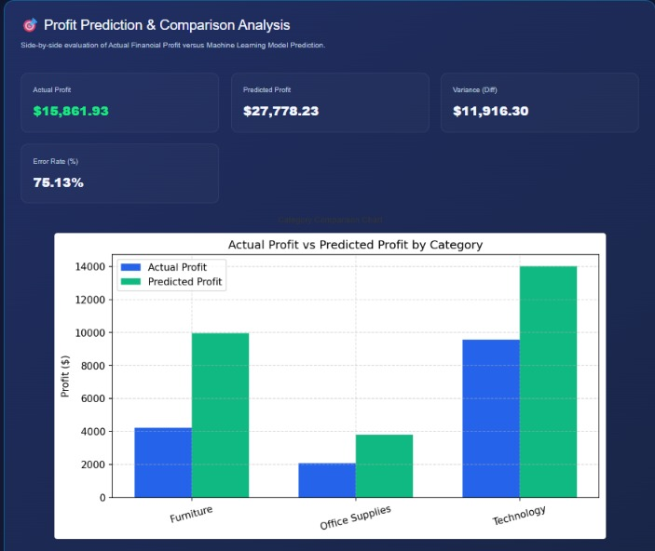
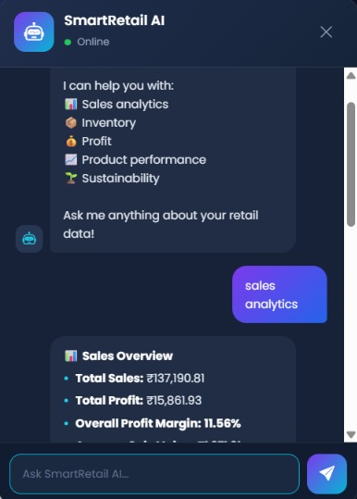
Profit Prediction & Comparison Analysis: Compares actual profit with the machine learning model’s predicted profit using category-wise visualizations and performance metrics.
SmartRetail AI Assistant: Provides interactive insights on sales, inventory, profit, product performance, and sustainability through natural-language queries.

Slide 12
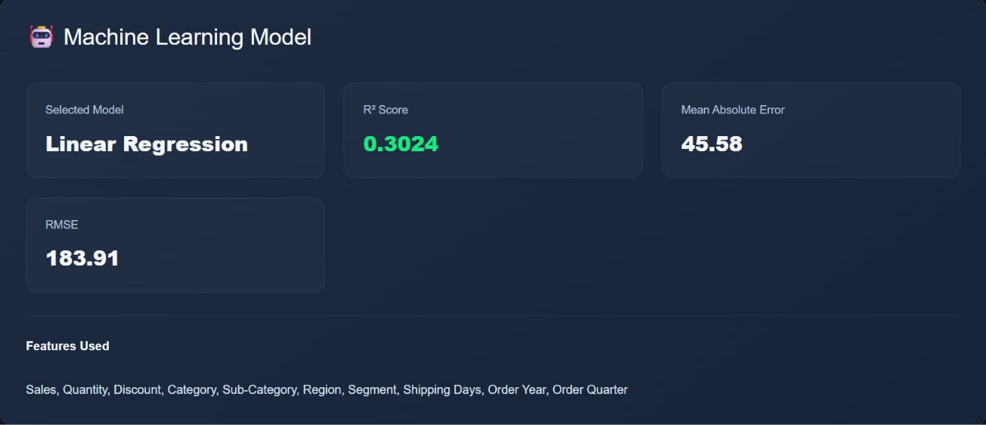
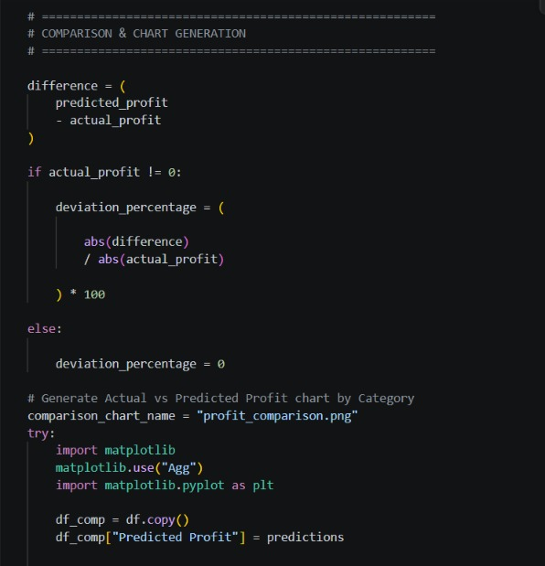
Machine Learning Model: Displays the Linear Regression model and evaluates its performance using R² Score, MAE, and RMSE based on selected retail features.
Comparison & Chart Generation: Calculates the difference between actual and predicted profit, determines the error percentage, and generates charts to visually compare model predictions.

Slide 13
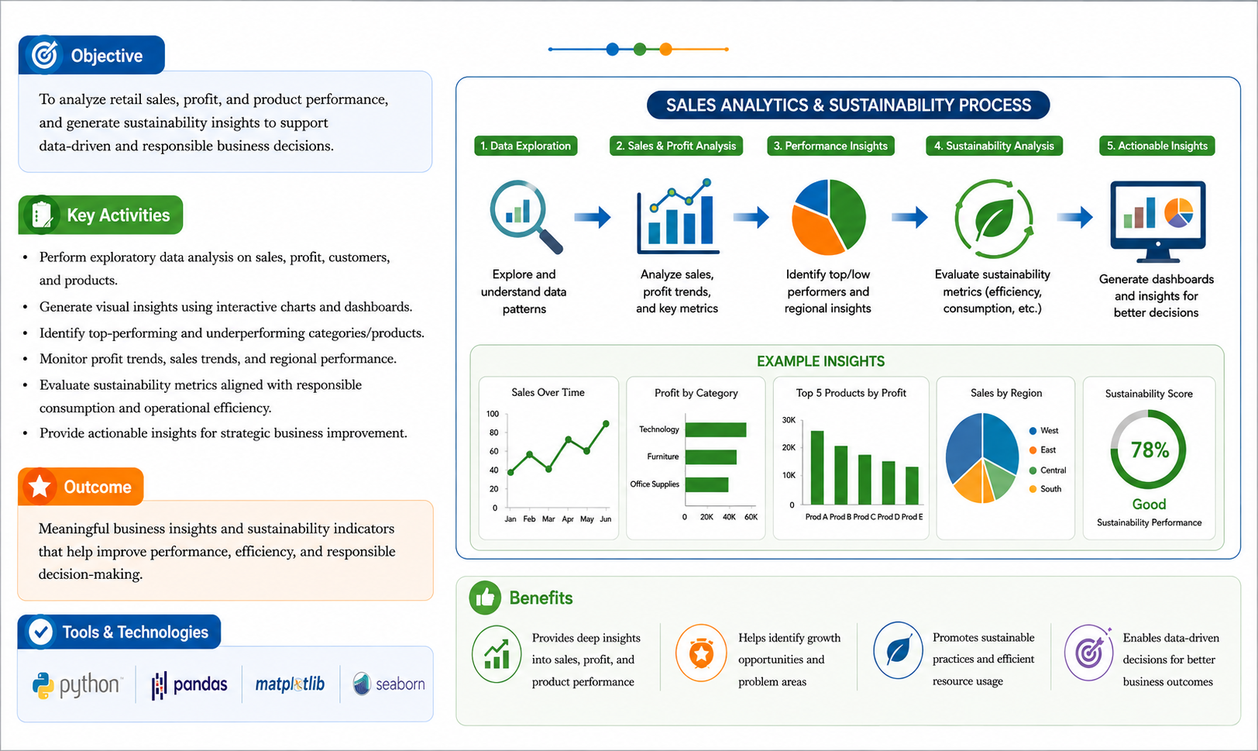
MODULE 3

Slide 14
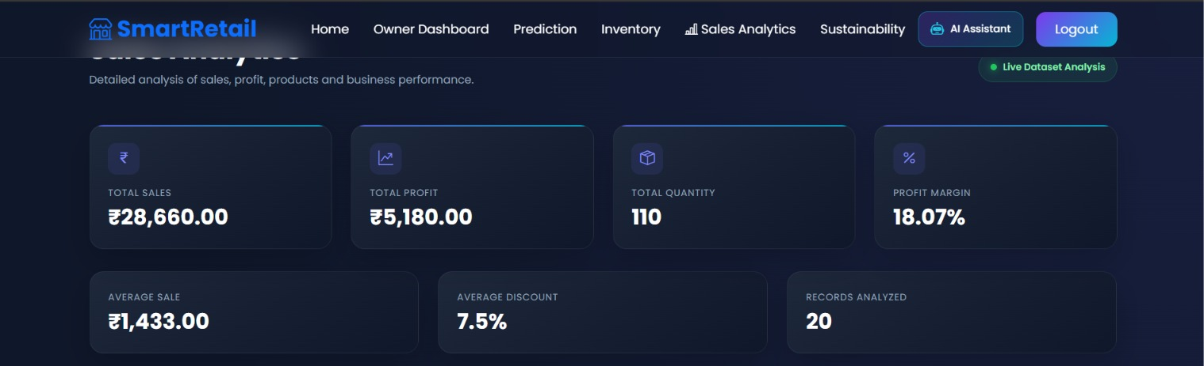
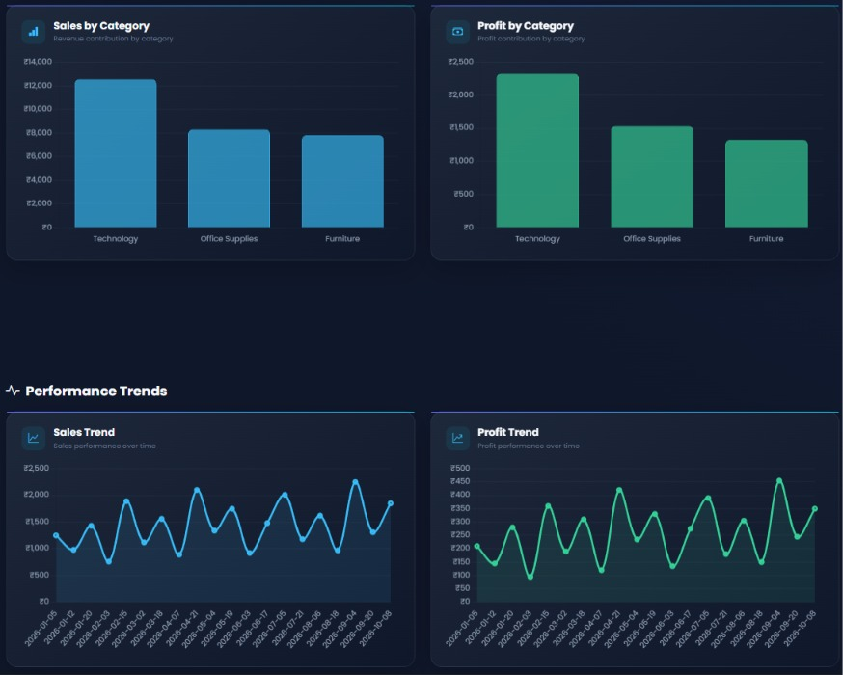
First Image: Displays the main Sales Analytics dashboard, showing key metrics such as total sales, total profit, quantity sold, profit margin, average sales, and discount.
Second Image: Presents detailed sales and profit visualizations, including category-wise comparisons and performance trends over time to identify business patterns.

Slide 15
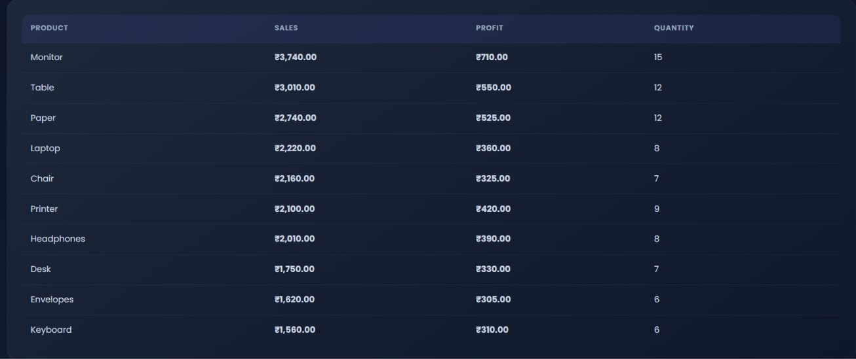
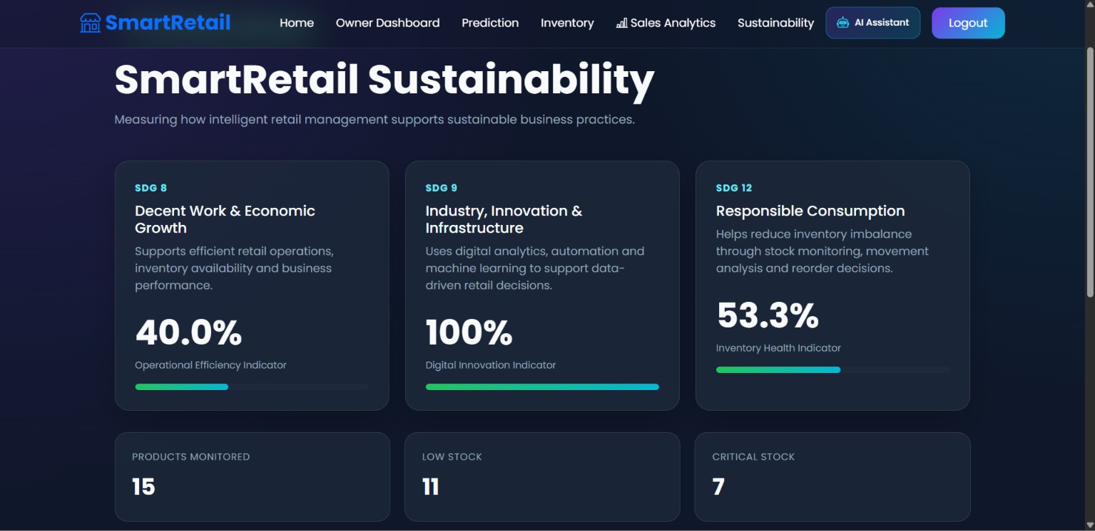
First Image:
Shows the Product Performance table, comparing products based on sales, profit, and quantity sold to identify the best-performing products.
Second Image:
Shows the Sustainability Dashboard, highlighting SDG indicators, inventory health, and stock levels to support responsible and efficient retail management.

Slide 16
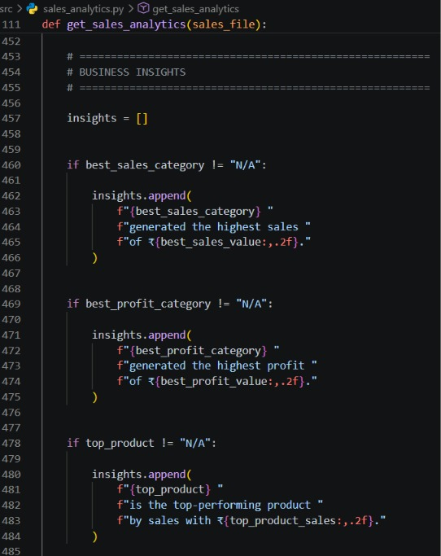
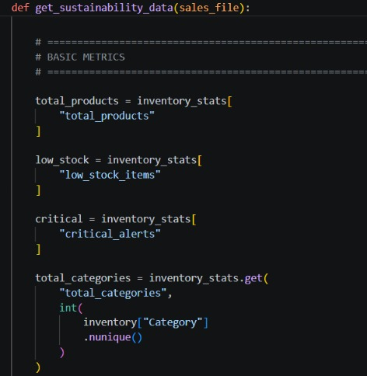
Image 1:
Sales Analytics : Generates business insights by identifying the highest-sales category and its sales value.
Sales Analytics : Identifies the highest-profit category and the top-performing product based on sales.
Image 2:
Sustainability : Calculates key inventory metrics such as total products, low-stock items, and critical stock alerts.
Sustainability : Determines the number of product categories and provides data for monitoring inventory health and sustainability.

Slide 17
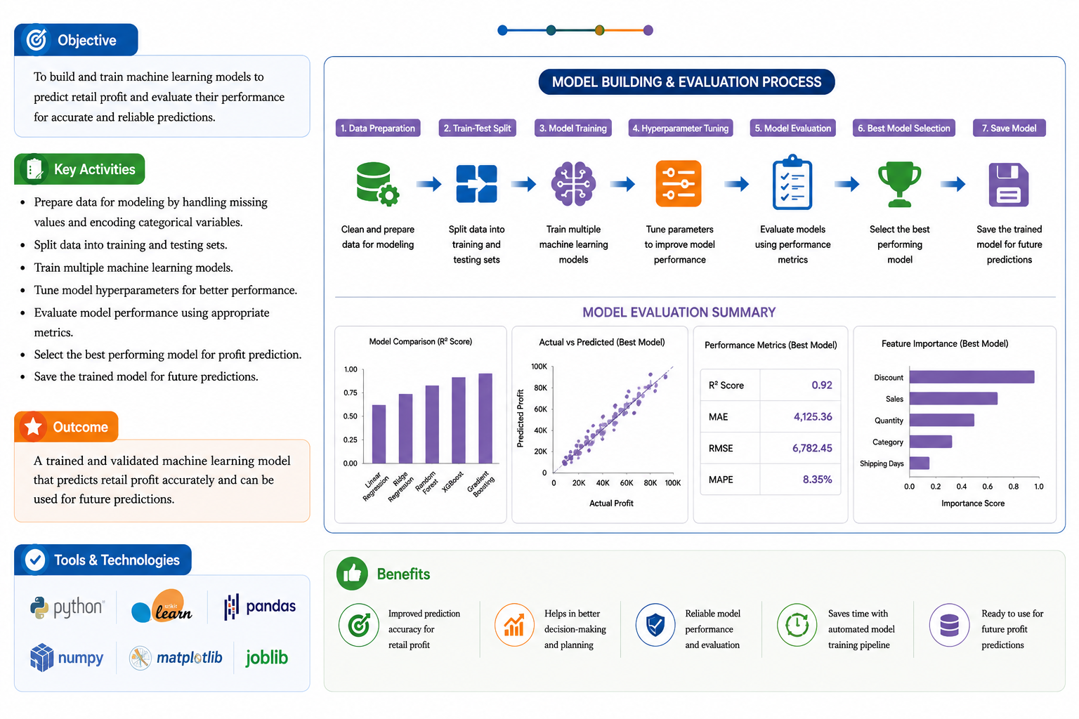
MODULE 4

Slide 18
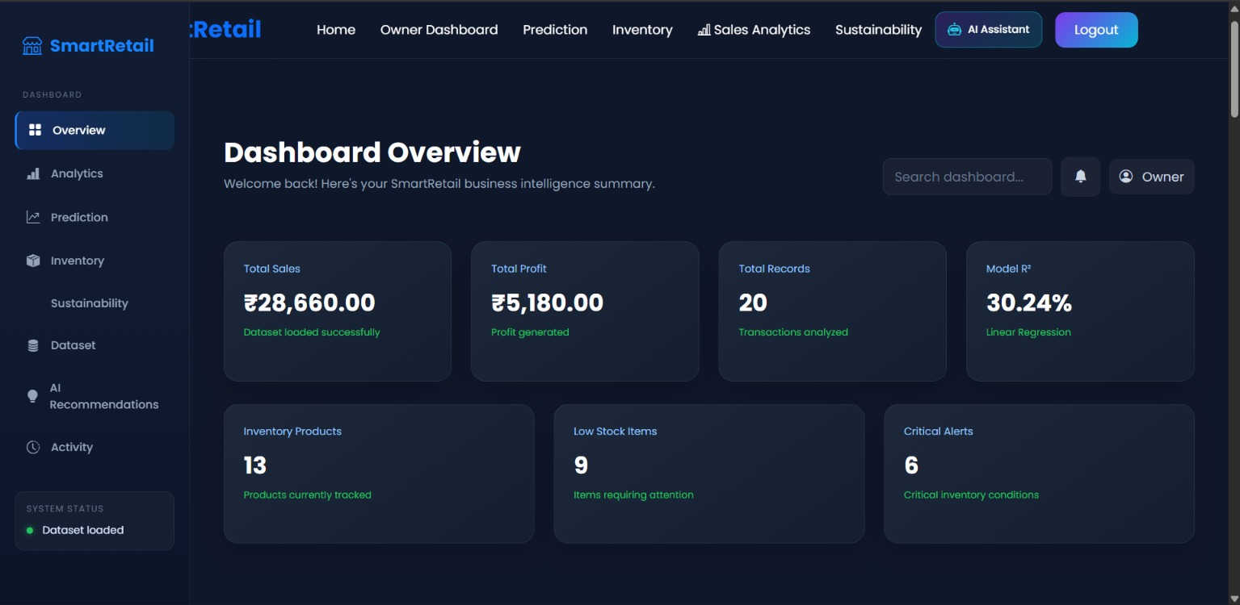
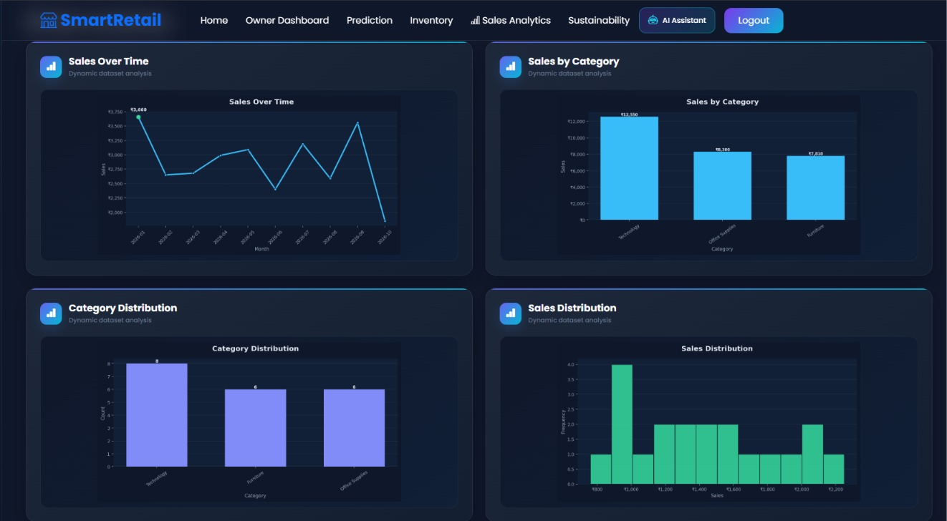
Dashboard Overview:
Displays key business metrics such as total sales, profit, records analyzed, model accuracy, and inventory status in one place.
Sales Analytics:
Provides detailed visual insights into business performance using sales trends, category-wise sales, category distribution, and sales distribution charts, helping users identify patterns and make data-driven decisions.

Slide 19
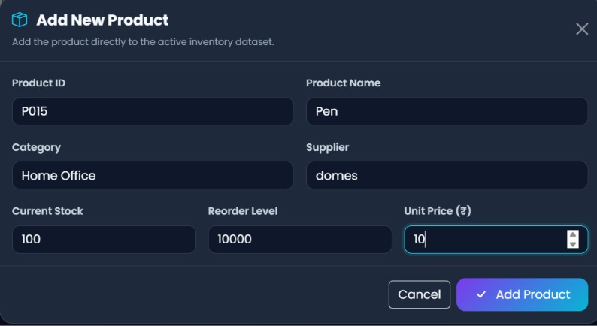
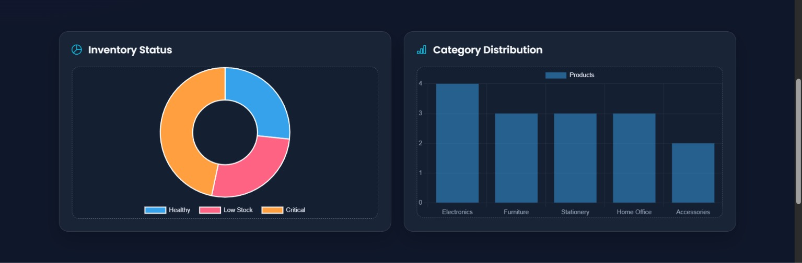
Add New Product:
Allows the user to enter product details such as ID, name, category, supplier, stock, reorder level, and unit price to update the inventory.
Inventory Analysis:
Displays inventory status and category distribution through charts, helping identify healthy, low-stock, and critical products and understand category-wise stock levels.

Slide 20
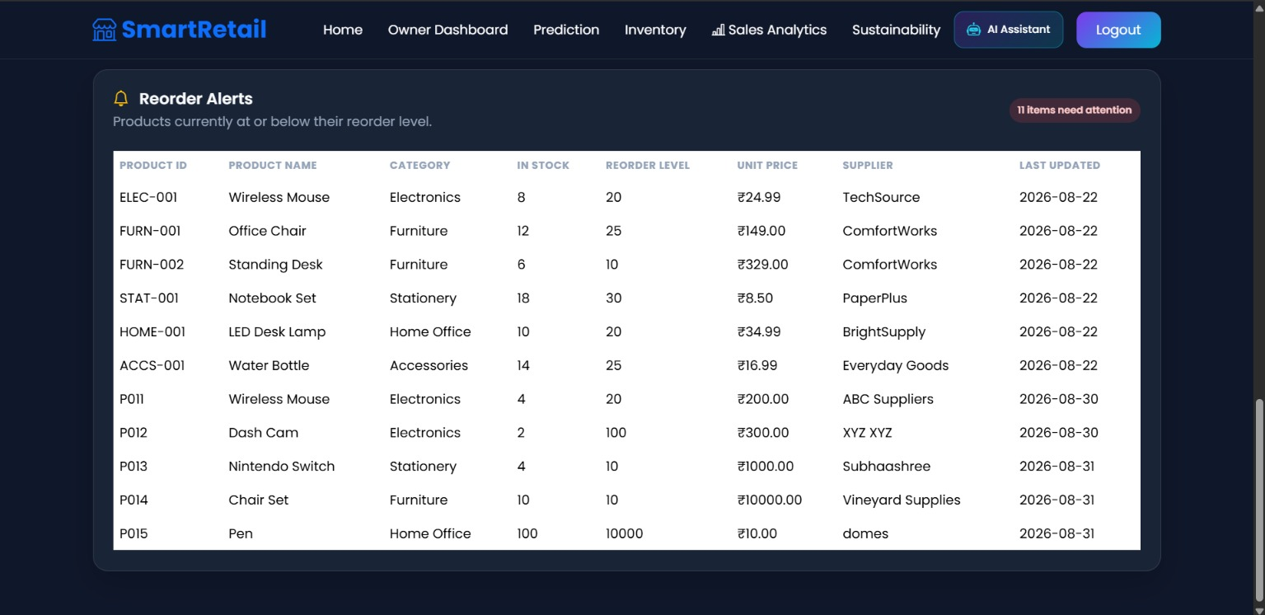
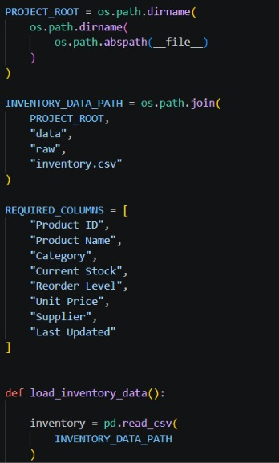
Reorder Alerts: Identifies products that are at or below their reorder level and displays key details such as stock, supplier, price, and last update for quick action.
Inventory Data Management: Loads the inventory CSV file using Python and validates required fields such as product ID, category, stock, reorder level, price, and supplier for reliable data handling.

Slide 21
CONCLUSION
SmartRetail proposes a comprehensive data-driven framework for analyzing and improving retail business operations.
The system integrates data preprocessing, exploratory analysis, predictive analytics, and intelligent recommendations into a single decision support platform.
It enables retail businesses to make accurate, efficient, and data-driven decisions for improved operational performance.
The proposed solution supports sustainable retail practices by optimizing inventory, pricing strategies, and resource utilization.
The project is expected to enhance business intelligence, profitability, and long-term sustainability while contributing to SDG 12: Responsible Consumption and Production.

Slide 22
FUTURE SCOPE
Real-Time Sales Forecasting – Integrate advanced forecasting models to predict future sales, demand, and profit trends.
Cloud-Based Deployment – Deploy SmartRetail on cloud platforms to enable secure access, centralized data storage, and scalability.
Mobile Application – Develop a mobile app for owners and inventory managers to monitor sales, stock levels, alerts, and predictions on the go.
Advanced AI Recommendations – Enhance the AI assistant to provide personalized pricing, promotion, inventory, and product recommendations using real-time business data.
IoT-Based Inventory Monitoring – Integrate IoT sensors and automated tracking systems for real-time stock monitoring and automatic reorder alerts.

Slide 23
REFERNCES
[1] W. McKinney, Python for Data Analysis: Data Wrangling with Pandas, NumPy, and Jupyter, 3rd ed. Sebastopol, CA, USA: O'Reilly Media, 2022.
[2] A. Géron, Hands-On Machine Learning with Scikit-Learn, Keras & TensorFlow: Concepts, Tools, and Techniques to Build Intelligent Systems, 3rd ed. Sebastopol, CA, USA: O'Reilly Media, 2022.
[3] J. Han, M. Kamber, and J. Pei, Data Mining: Concepts and Techniques, 3rd ed. Burlington, MA, USA: Morgan Kaufmann, 2012.
[4] Tableau Software, "Sample Superstore Dataset," Tableau. [Online]. Available: https://www.tableau.com. [Accessed: Jul. 25, 2026].
[5] Scikit-learn Developers, "Scikit-learn: Machine Learning in Python," Scikit-learn Documentation. [Online]. Available: https://scikit-learn.org. [Accessed: Jul. 25, 2026].

Slide 24
THANK YOU !

